Slide 1
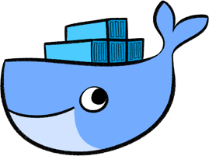
Docker Platform overview
Lesson 02: Docker platform overview
Notes:
Add instructor notes here.

Slide 2
Lesson Objectives
In this lesson, you will learn:
Docker Platform
Docker Engine
Docker Images
Docker containers
Registry
Repositories
Docker Hub
Notes:
Docker Platform
Docker Engine
Docker Images
Docker containers
Registry
Repositories
Docker Hub
Deploying Jar file in a Docker and push the Docker image to Repository
This lesson is to give an Introduction on Java Server Pages

Slide 3
2.1: Docker Platform Docker Platform?
A container platform is complete solution that allows organizations to solve multiple problems across a diverse set of requirements.
it delivers sustainable benefits throughout your organization by providing all the pieces an enterprise operation requires
security,
governance,
automation,
support and certification over the entire application lifecycle.
.

Slide 4
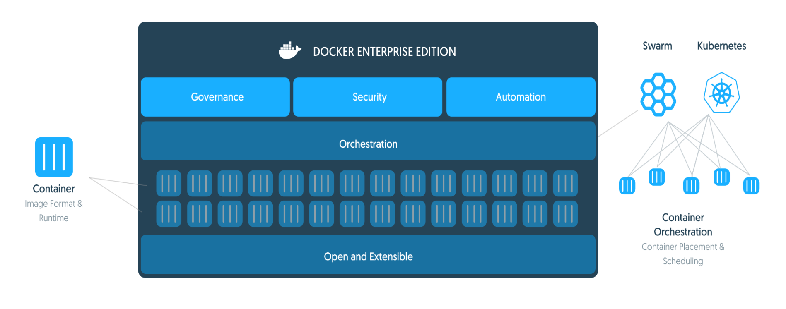
2.1: Docker Platform Docker Platform?
Docker Enterprise Edition (EE) is an enterprise-ready container platform that enables IT leaders to choose how to cost-effectively build and manage their entire application portfolio at their own pace, without fear of architecture and infrastructure lock-in.

Slide 5
2.1: Docker Platform Docker Platform Use cases?
MODERNIZE TRADITIONAL APPS :
Packaging existing apps into containers immediately improves security, reduce costs, and gain cloud portability
Hybrid Cloud :
Docker packages applications and their dependencies together into an isolated container can be run in any infrastructure(Cloud migration, multi-cloud or hybrid cloud infrastructure )
CONTINUOUS INTEGRATION AND DEPLOYMENT [DEVOPS] :
Docker enables a true separation of concerns to accelerate the adoption of DevOps processes.
Microservices :
Docker containers are lightweight by design and ideal for enabling microservices application development
Notes:
MODERNIZE TRADITIONAL APPS
Packaging existing apps into containers immediately improves security, reduce costs, and gain cloud portability. This transformation applies modern properties to legacy applications - all without changing a single line of code.
HYBRID CLOUD
Cloud migration, multi-cloud or hybrid cloud infrastructure require frictionless portability of applications. Docker packages applications and their dependencies together into an isolated container making them portable to any infrastructure.
Docker certified infrastructure ensures the containerized applications work consistently.

Slide 6
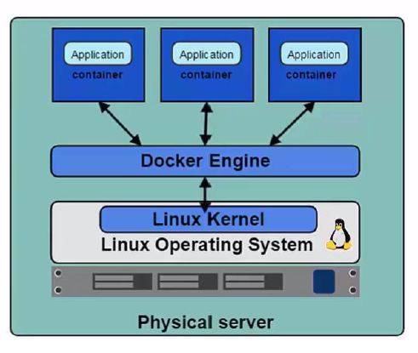
2.2: Docker Engine Docker Engine?
Docker Engine is a program which enables container to be built , ship and run.
it user Linux Kernel namespaces
and control groups .
Namespace gives us the isolated
workspace .

Slide 7

2.2: Docker Engine Docker Engine?
Docker Engine is a part of the Docker , which creates and runs the Docker container.
Docker container
is a live running
instance of a
Docker image .
Notes:
The Docker engine is a part of Docker which create and run the Docker containers. The docker container is a live running instance of a docker image. Docker Engine is a client-server based application with following components -
A server which is a continuously running service called a daemon process.
A REST API which interfaces the programs to use talk with the daemon and give instruct it what to do.
A command line interface client.

Slide 8
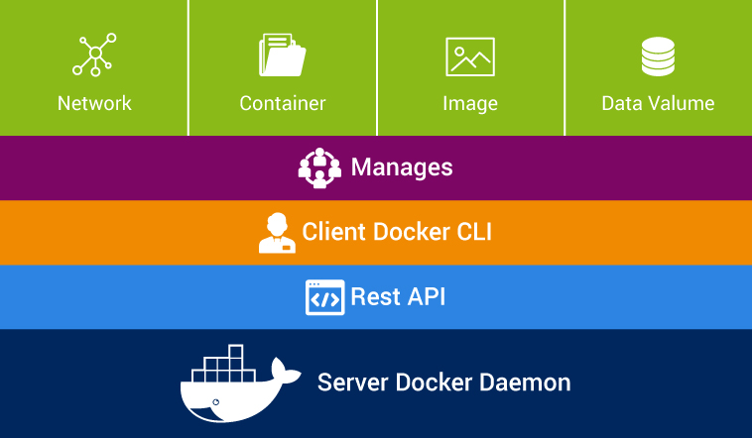
2.2: Docker Engine Docker Engine?
Notes:
The command line interface client uses the Docker REST API to interact with the Docker daemon through using CLI commands.
Many other Docker applications also use the API and CLI.
The Docker daemon listens to only Docker API requests and handles Docker images, containers, networks, and volumes.
It also communicates with other daemons to manage Docker services .
In Docker, client can interact with more than one daemon process.

Slide 9
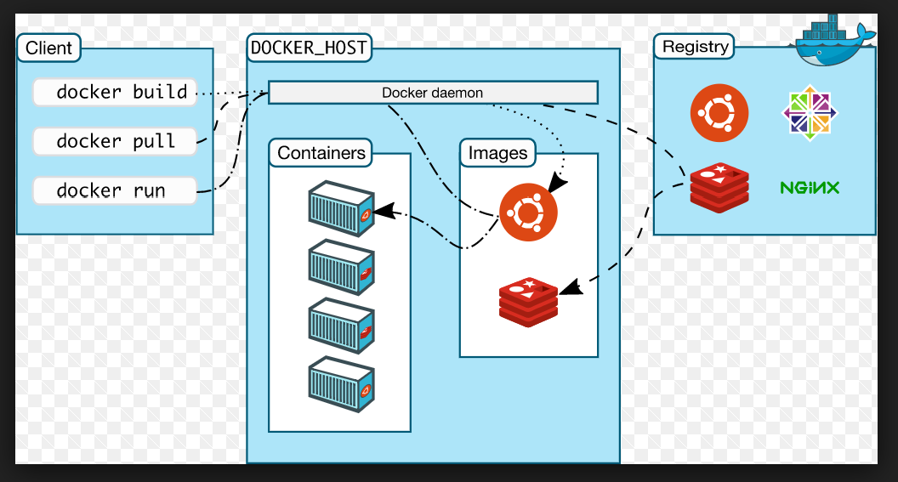
2.2: Docker Engine Docker Work flow
Notes:
The command line interface client uses the Docker REST API to interact with the Docker daemon through using CLI commands.
Many other Docker applications also use the API and CLI.
The Docker daemon listens to only Docker API requests and handles Docker images, containers, networks, and volumes.
It also communicates with other daemons to manage Docker services .
In Docker, client can interact with more than one daemon process.

Slide 10
2.3: Docker Images Docker Images
Docker Image :
It is a Read only templates used to create container
Build by you or other Docker user
Stored in Docker Hub or in your local Registry

Slide 11
2.3: Docker Images Docker Images
Docker Images are the most build part of docker life cycle.
We can build an image which is based on the centos image .
An image can be created based on another image, with some additional customization in the image.
We can create our own images or only use those created by others and published in registry directory.
Notes:
We can build an image which is based on the centos image, which can install the Nginx web server with required application and configuration details which need to make the application run.

Slide 12
2.3: Docker Images Steps to Docker Images
Follow the Steps :
Dockerfile needs to be created with some syntax contains the steps that needed to create the image and make to run it.
Each instruction in a Dockerfile creates a new layer in the image.
For any modification in Dockerfile later on needed rebuild the image and the layers which have changed are rebuilt.
Notes:
We can build an image which is based on the centos image, which can install the Nginx web server with required application and configuration details which need to make the application run.

Slide 13
2.3: Docker Images DockerFile
It is a text file which consists of all commands so that user can call on the command line to build an image .
The docker file can be considered as the source code and images to make compile for our container which is running code .
The Dockerfile are portable files which can be shared, stored and updated as required.
Notes:
We can build an image which is based on the centos image, which can install the Nginx web server with required application and configuration details which need to make the application run.

Slide 14
2.3: Docker Images Docker File - Commands
Docker file instruction:
From : Set the Base image for instruction
Maintainer : - Shows Author of DOC file
Run : Allows to execute the command
CMD :- It shows the command , which are used in image
Label :- It shows metadata(Key – Value pairs)
Expose : listen on specific as required by application servers
ENV : - set the environment variables in the Docker file for the container
COPY: - copy file from source to destination
WORKDIR : -- set the current working directory for the other instruction, i.e., RUN, CMD, COPY, etc.
The Dockerfile are portable files which can be shared, stored and updated as required.
Notes:
Some of the docker files instruction is -
FROM - This is used for to set the base image for the instructions. It is very important to mention this in the first line of docker file.
MAINTAINER - This instruction is used to indicate the author of the docker file and its non-executable.
RUN - This instruction allows us to execute the command on top of the existing layer and create a new layer with the result of command execution.
CMD - This instruction doesn’t perform anything during the building of docker image. It Just specifies the commands that are used in the image.
LABEL - This Instruction is used to assign the metadata in the form key-value pairs. It is always best to use few LABEL instructions as possible.
EXPOSE - This instruction is used to listen on specific as required by application servers.
ENV - This instruction is used to set the environment variables in the Docker file for the container.
COPY - This instruction is used to copy the files and directory from specific folder to destination folder.
WORKDIR - This instruction is used to set the current working directory for the other instruction, i.e., RUN, CMD, COPY, etc.

Slide 15
2.4: Docker Container Docker Container
One can create , run ,stop or delete a container using Docker CLI
One can connect the Container to more than one network or even create a Image based on it’s current state.
Docker container:
is a live running instance of a Docker image .
It is isolated application platform which contains every thing that needed to run your application based on one or more images
It is isolated from other container and system machines
Notes:
A container is the instance of an image. We can create, run, stop, or delete a container using the Docker CLI. We can connect a container to more than one networks, or even create a new image based on its current state.
By default, a container is well isolated from other containers and its system machine. A container defined by its image or configuration options that we provide during to create or run it.

Slide 16
2.4: Docker Container Namespace
It is a service in Docker , provides isolated environment called as container.
When one run the Container , Docker creates a set of namespace for that container.
It provides a layer of isolation:
Namespace PID :-- It provides isolation for the allocation of the process, lists of processes with details
Namespace network :-- isolates the network interface controllers, IP tables firewall rules, routing tables etc.
Notes:
Namespace PID : - It provides isolation for the allocation of the process, lists of processes with details. In new namespace is isolated from other processes in its "parent" namespace still see all processes in child namespace
Namespace network isolates the network interface controllers, IP tables firewall rules, routing tables etc. Network namespaces can be connected with each other using the virtual Ethernet device.

Slide 17
2.4: Docker Container Control groups
Docker Engine in Linux relies on named control groups , which limits the application to a predefined set of resources.
Docker Engine use the Control groups to share the available Hardware resources to containers.
Using control groups, one can define the memory available to a particular container.
Notes:
Namespace PID : - It provides isolation for the allocation of the process, lists of processes with details. In new namespace is isolated from other processes in its "parent" namespace still see all processes in child namespace
Namespace network isolates the network interface controllers, IP tables firewall rules, routing tables etc. Network namespaces can be connected with each other using the virtual Ethernet device.

Slide 18
2.4: Docker Container Union File systems and container format
Union file systems is a file system which is used by creating layers, making them lightweight and faster.
Docker Engine using UFS provide the building blocks to containers.
Using control groups, one can define the memory available to a particular container.
Container Format :- It is a file which Docker Engine use to adds the namespaces, control groups & UnionFS .
The default size for the container is lib container.
Notes:
Docker Engine uses many UnionFS variants some of including are AUFS, btrfs, vfs, Device Mapper, etc.

Slide 19
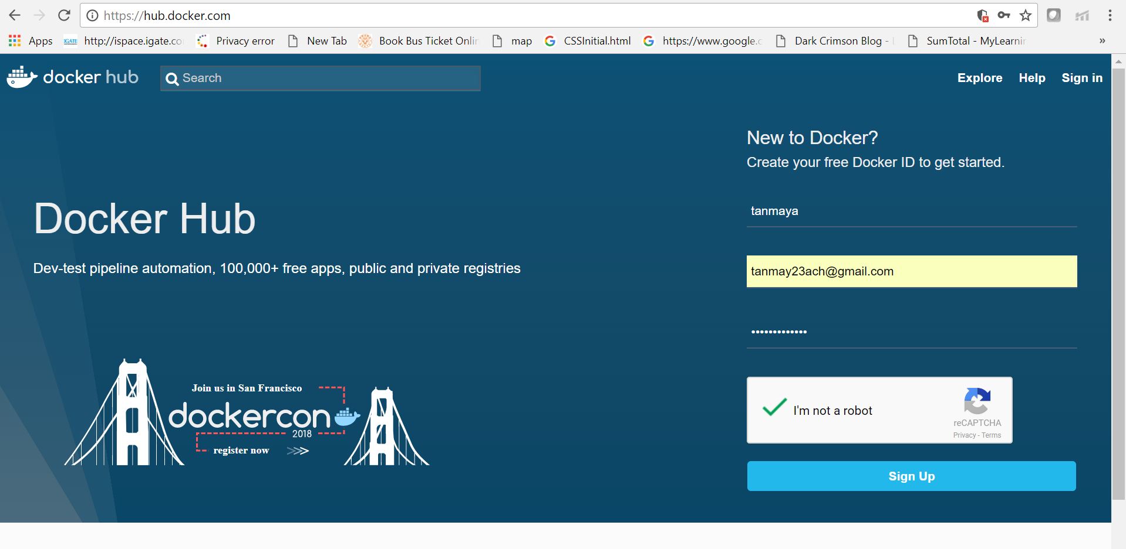
Docker HUB
Notes:
Docker Engine uses many UnionFS variants some of including are AUFS, btrfs, vfs, Device Mapper, etc.

Slide 20
2.8: Deploying jar file in a Docker Demo
Demo on:
Deploying Jar file into Docker and Push the image to Docker hub( Steps given in Note section)
Notes:
Step 1 : Develop a simple Helloworld App and import the jar File to your EC2 instance and note the public IP address to connect .
Step 2: In your Window platform Use the puttygen and putty.exe files to connect to your Linux server instance in AWS .
Type the command to create an image and check the application deployment
Step 3 : Once the docker service started , Type below command
sudo usermod -a -G docker ec2-user
Step 4: Type the command to check the images and container Id (Optional)
Step 5: Create a Dockerfile with below lines
FROM frolvlad/alpine-oraclejdk8:slim
ADD DockerHelloDemo.jar app.jar
ENTRYPOINT [ “sh”, “-c”, “java –jar app.jar” ]
Step 6 : Type the command to build an image
Docker build –t mydockerfstdemo .
Repeat Step 4 to check your image and container
Type the command to run the Docker container
Step 7: docker run mydockerfstdemo
Step 8 : Now push the Docker image to Dockerhub repo . Type the command
export DOCKER_ID_USER="tanmay23“
docker login
docker tag mydockerfstdemo $DOCKER_ID_USER/fstdockerdemo
docker push $DOCKER_ID_USER/fstdockerdemo
Step 9: Login to dockerhub repo and see your Docker.

Slide 21

Summary
In this lesson, you have learnt:
Introduction to Docker
How Docker provides Solution in SW or Application impl
Limitation of VM
What is Containerization
The Differences between VM and Container
Docker Architecture
Docker community

Slide 22
Review – Questions
Question 1: _______ is a part of the Docker , which creates and runs the Docker container Docker container is light weight then VM.
Question 2 : _______________is a live running instance of a Docker image
Notes:
Answers for the Review Questions:
Answer 1: Docker engine
Answer 2: Docker container

